Slide 1
Team Violet: Group Project
Josh Schmid
Jeremy Simon
Ananya Subburathinam

Slide 2
Presentation Outline
Introduction
Requirements
Uncertainty and Entropy
Organization and Presentation
Design and Semiotics
Architecture
Evaluation
Conceptual and Logical Models
Prototype Demonstration

Slide 3
Introduction
Topic: Vehicle recommendation service tailored toward students
Why?
Existing recommendation services are very general
Students have specific requirements
Relatively low purchase cost
Low maintenance costs and minimal maintenance requirements
High reliability
“Coolness” and appearance not the main priority
Recommendation services generally don’t account for available discounts
A new service would combine dealer and maintenance databases to make recommendations

Slide 4
Functional Requirements
Provide a list of vehicles for sale in the area
Vehicles should meet all user-specified criteria
Should have good repair records, low maintenance costs, and relatively low purchase costs
Vehicle list should be user-sortable
Provide detailed information about vehicles for sale if requested by user.
Technical info, pictures, location
Provide links and contact info for dealerships holding a vehicle
Dynamic database
Update no less than once every 24 hours

Slide 5
Non-Functional Requirements
Portal must be accessible by several individuals at the same time
Portal must be accessible from several commonly-used browsers
The portal should have read-only access into the database
Computation time required to present a list of solutions to the user should be no more than 10 seconds
Portal should run without intervention of the human technician on at least 95% of days

Slide 6
Use Case: Uncertainty and Entropy Aspects
Site designed for a user group who many not have experience buying cars
Use common terms as much as possible
Term definitions
Make, model, vehicle type
How up-to-date are dealer records?
Images
Images should accurately reflect featured vehicles
Limit use of images to what is necessary
Must attempt to minimize entropy with design
No unnecessary images, wild colors, etc.

Slide 7
Organization and Presentation Needs
Four-tiered page design
Title and brief description
Header image
Search box
Has several filter categories in drop-down lists
Keyword search bar
Results list
Refreshes with each new search
Must work on several major Internet browsers
Not currently optimized for mobile use
Necessary if implemented beyond initial prototype

Slide 8
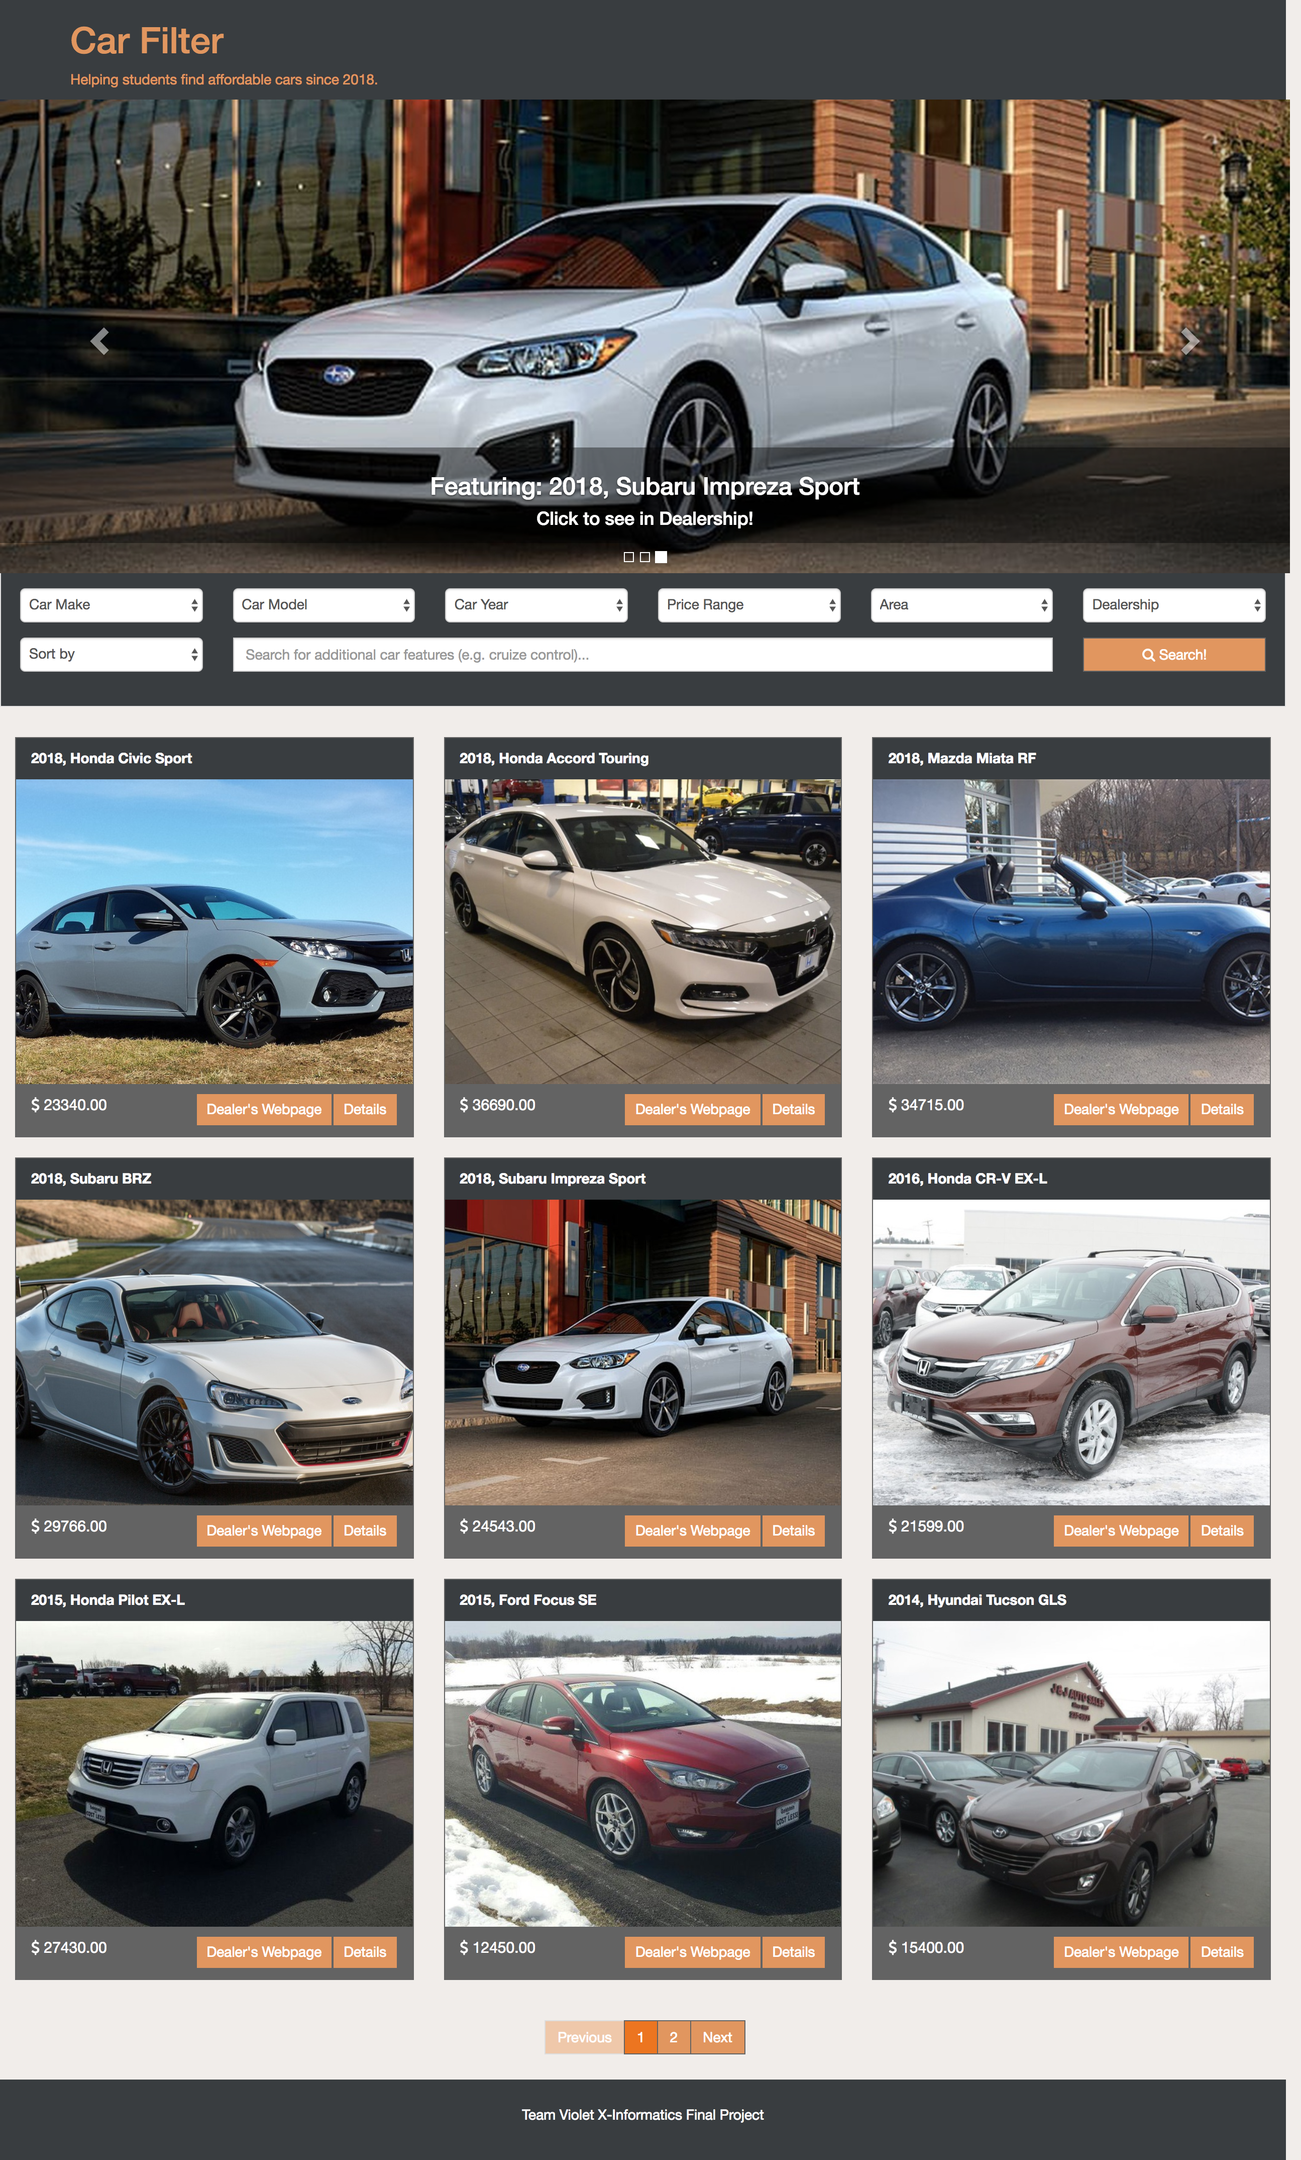
Prototype Architecture
Main page:
Title
Carousel of suggested cars
Search functionality
Search results
Links for more details, and dealership page
Modal for more details:
A modal pops up on requesting ‘Details’
Contains more information about the car
Title in header, more information in the body, and link to the dealership and close in footer.
Coded in Python, using Django
Data currently manually entered for ease of prototyping
Could be automated in real-life full-scale release

Slide 9
Design Principles
Color
The color scheme - earthy tones, warm colors
Orange tones - attention, fun, energy
Grey tones - technology, innovation
White font over dark backgrounds - draw attention, stand out clearly
Emphasis
Emphasis on search functionality and cars.
Moving carousel to advertise the admins’ picks
White search bars and drop down menus stand out when user first sees page
Orange of the buttons and the title are meant to draw attention as well
Brighter shade to highlight an active button
Font sizing considerations for optimal clarity and denoting hierarchy
Unity
The whole page follows the same color scheme and shades in headers, body and footers
Repetition
The repeated search result items follow the same pattern, encapsulated as one with the header, icon, and footer
All the buttons are made orange for a consistent representation.
Transition
Clicking on the search button auto-scrolls down to the results to draw the users’ attention
Notes:
https://www.ecommerce-nation.com/color-psychology-for-ecommerce/
Orange:
Aggressive: Orange is great for calls to action like subscribe, buy, or sell. At the same time, this color makes a buyer feel confident.
Gray:
Balance and innovation: Gray is the color that we see when we think of technology- and for good reason. This color is anything but bland- and can be used effectively to symbolize neutrality, innovation, and knowledge.
https://quizlet.com/23095570/chapter-12-principles-of-design-flash-cards/

Slide 10
Semiotics
Icons:
Pictures of the cars, signifying the car they represent
Symbols
“Previous” and “Next” buttons, and numbered buttons to move between results pages.
Left and right arrows to change what is displayed on carousel
Up and down arrows in the drop down lists
The three dots at bottom of carousel, the highlight signifying which image is currently displayed
Textual descriptions, and words on buttons
Buttons, associated with clickable objects that perform some action on click
Text on button signifies what action will be performed.

Slide 11
References used
Car Sales Websites:
https://www.autotrader.com/ :
Has cars for sale, searchable by make, model, location, year, etc
https://www.carsdirect.com/:
Searchable by make, model, location, price range
Design elements:
https://www.ecommerce-nation.com/color-psychology-for-ecommerce/ :
Color psychology and its influence on e-commerce and purchasing behavior of customers
https://www.shopify.com/partners/blog/93130630-10-beautiful-ecommerce-website-color-schemes :
Lists ten e-commerce website color schemes (including one that ours is based on - http://www.patagoniaprovisions.com/ )

Slide 12
Evaluation & Improvements
Tested functional requirement satisfaction and overall understandability and ease of use.
Adjusted positioning of text, added color to headers and footers around each search result icon.
Added a non-intrusive separating line in to show separation between car details and dealer details in the more-details modal.
Initial use case idea to use $, $$, $$$ symbols to denote price range dropped in favor of numerical values.
Search by ‘reliability’ removed to reduce confusion if users are not aware. Reliability score now available in details, for users who wish to know.
VIN not mentioned in our site, but can be found on dealership website.
Prototype was tested to ensure compliance with requirements.
Added close button to more-details modal, in addition to ‘x’ close button on the top-right corner.

Slide 13
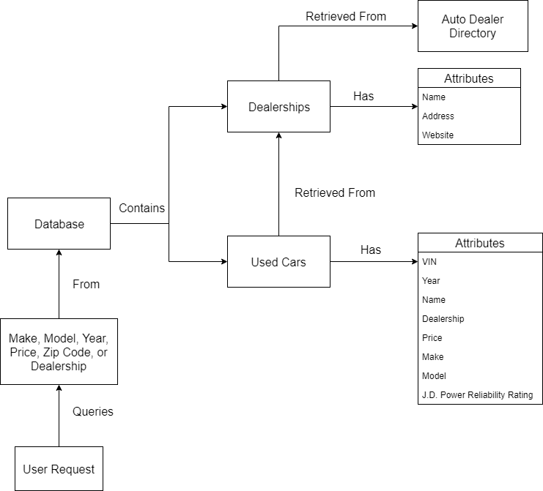
Conceptual Overview

Slide 14
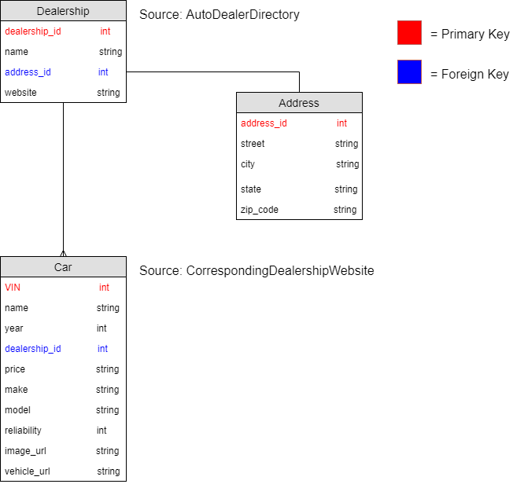
Database Model

Slide 15
Prototype Demonstration
http://127.0.0.1:8000/cars/

Slide 16
References
Design:
https://www.ecommerce-nation.com/color-psychology-for-ecommerce/
https://digitalsynopsis.com/design/website-color-schemes-palettes-combinations/
https://www.awwwards.com/trendy-web-color-palettes-and-material-design-color-schemes-tools.html
https://www.canva.com/learn/website-color-schemes/
https://www.patagoniaprovisions.com/
https://www.shopify.com/partners/blog/93130630-10-beautiful-ecommerce-website-color-schemes
https://en.wikipedia.org/wiki/Visual_design_elements_and_principles
Images and data:
https://www.rensselaerhonda.com/
https://www.victoreidautosales.com/
https://www.carbonesubaruoftroy.com/
https://cooleymazda.com/
https://www.victoreidautosales.com/
http://onlinejj.com/
https://www.goldsteinchryslerdodgejeep.com/
https://www.northeastacura.com/

Slide 17
References
Prototype coding:
https://www.djangoproject.com/
https://sorl-thumbnail.readthedocs.io/en/latest/

Slide 18
Questions?

